Slide 1
Amazon Shipping Analytics
File created on: 2/1/2023 6:16:22 PM

Slide 2
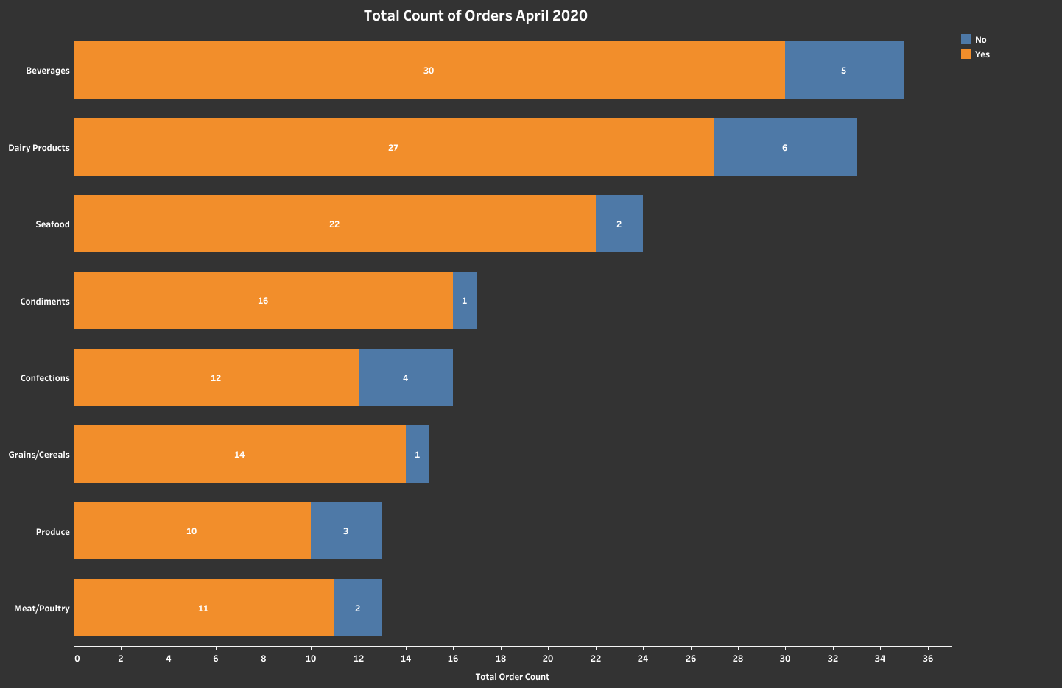

Slide 3
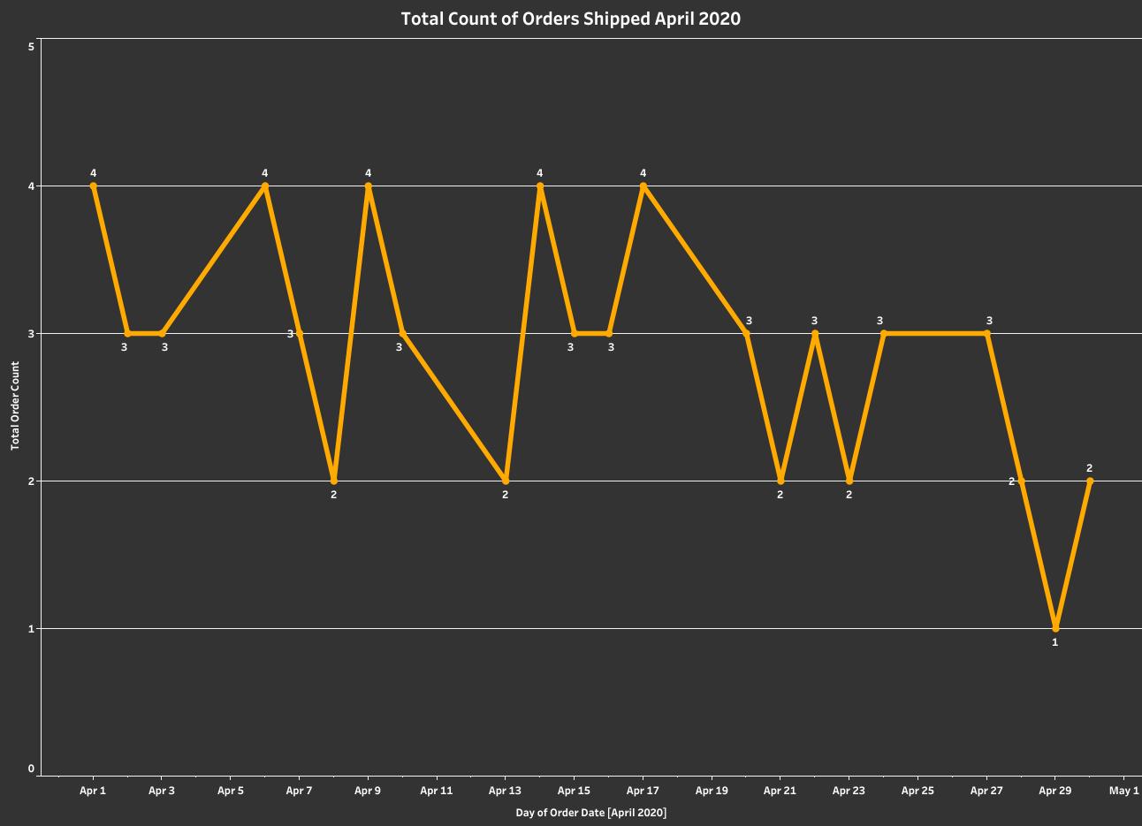

Slide 4
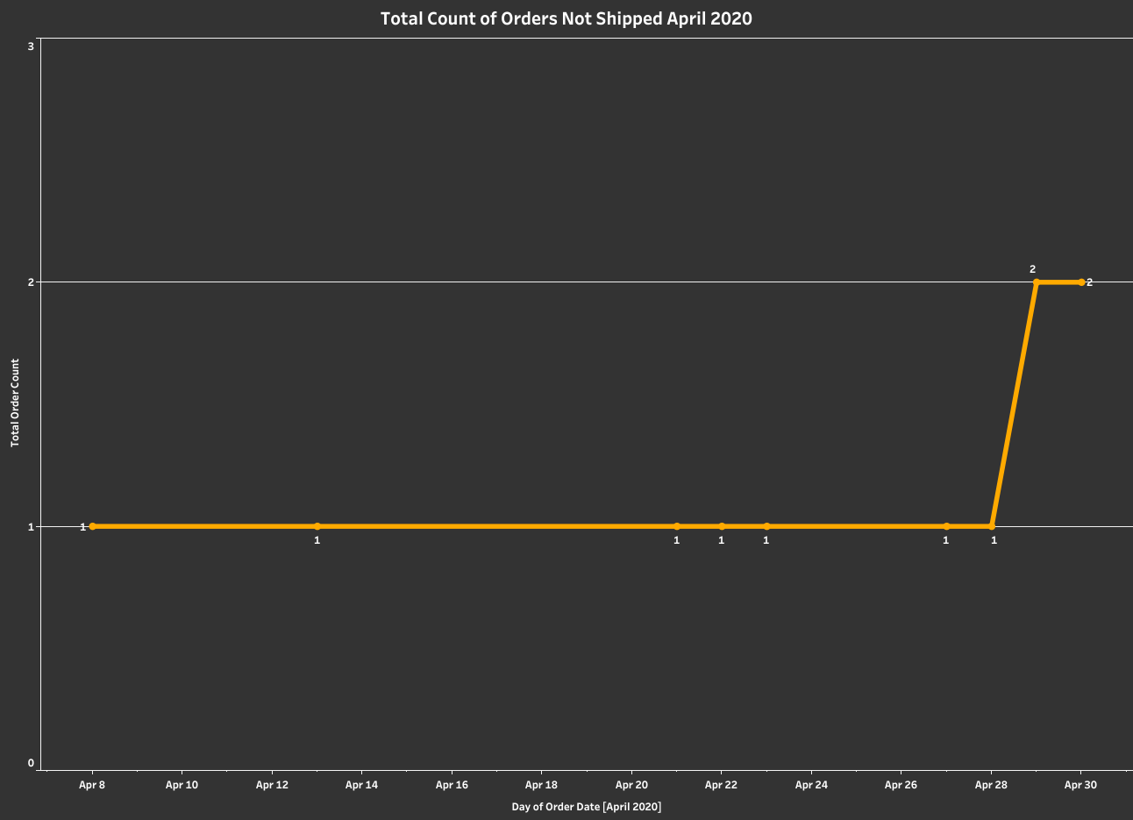

Slide 5
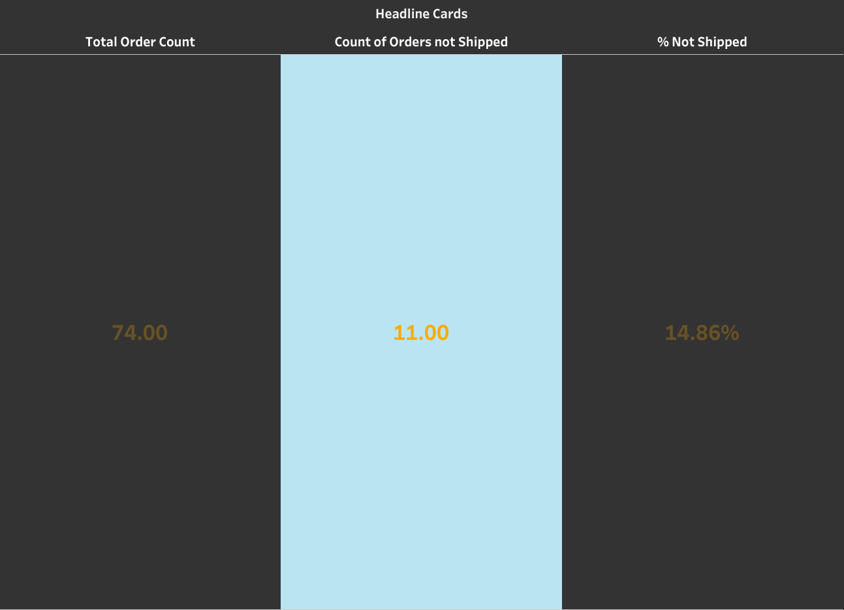

Slide 6
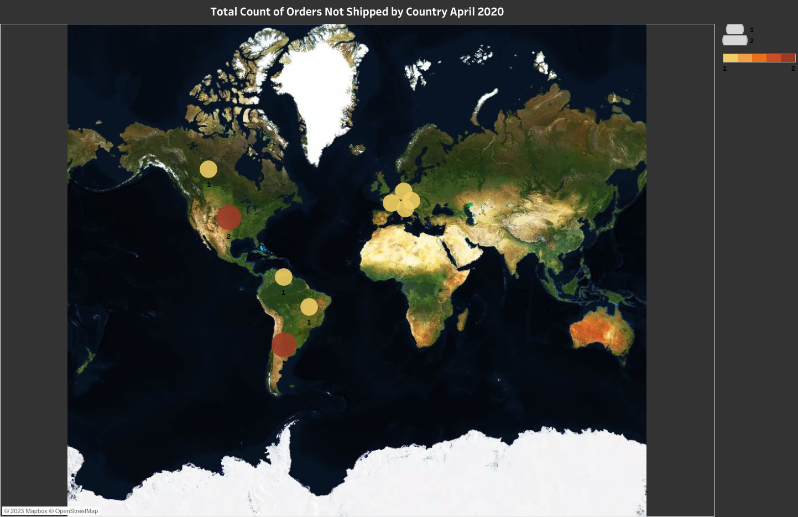

Slide 7
